Slide 1
Tritronik QoS Tool
Proposed Solution

Slide 2
Contents
Background
Solution
Timeline
Demo Spec
Summary

Slide 3
Background
Problems
Requirements

Slide 4
Problems
MNOs need to send field personnel to measure their service quality and their competitor’s
MNOs need to process collected data manually in order to have meaningful and useful information

Slide 5
Requirements
Able to compare QoS of different service packet and operator
Able to measure voice call, sms, internet, and chatting app services
Get location of data collection
Can be operated in mobile asset (e.g. car and bus)
Has local database when connection is unavailable

Slide 6
Solution
Architecture
Parameters
Features

Slide 7
Architecture

Slide 8
Hardware

Slide 9
Network Parameters
Operator name
Signal strength
Network type (cellular and internet)
Ping duration (min, avg, max, mdev)
Download and upload speed
Connected tower

Slide 10
Service Parameters
Voice
PESQ MOS
POLQA MOS
SMS
Service accessibility
Message delivery rate
Message delivery time

Slide 11
Service Parameters Cont.
Website
Load time
Response status
Chatting app
Ping duration to app server

Slide 12
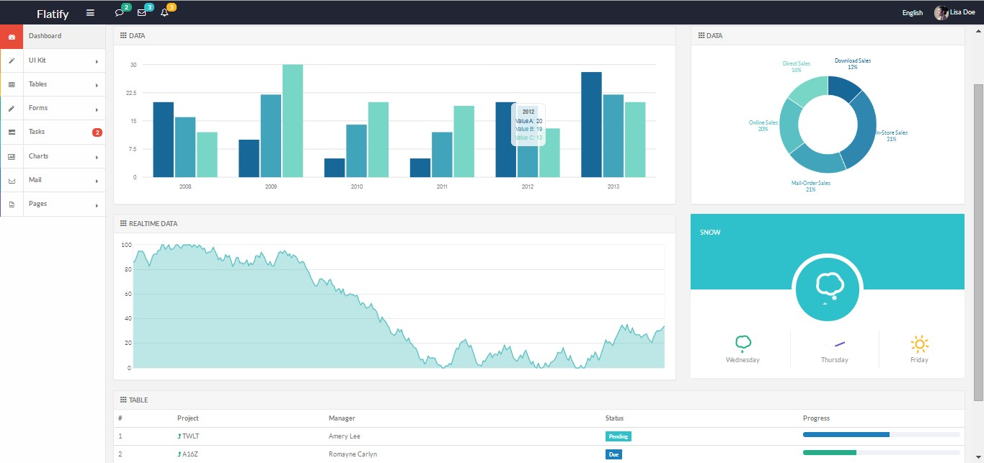
Dashboard
Not actual web app
See real time and historical data
Get notification
Get report

Slide 13
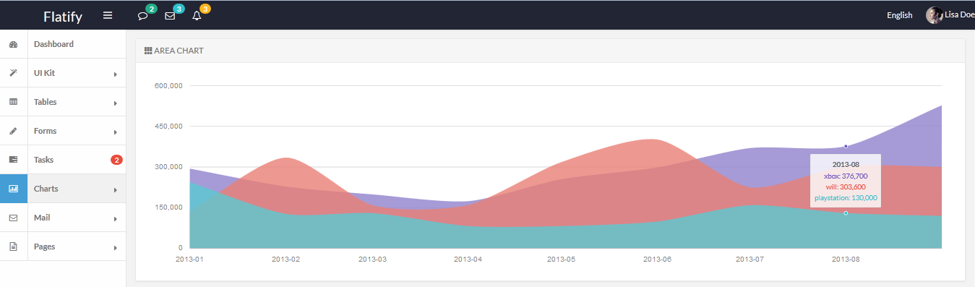
Comparison Chart
Not actual web app
Compare your performance with other operators

Slide 14
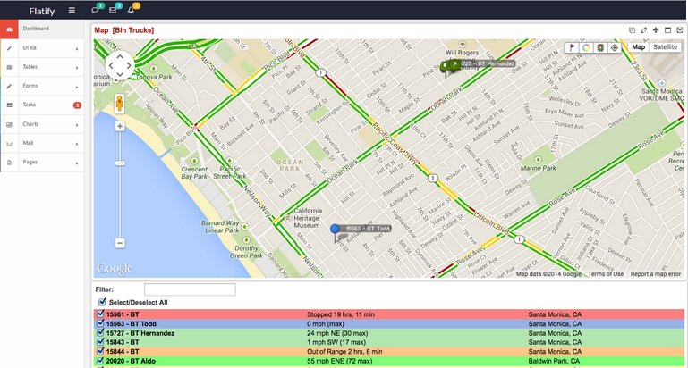
IntelliMap
Not actual web app
View your service performance on areas

Slide 15
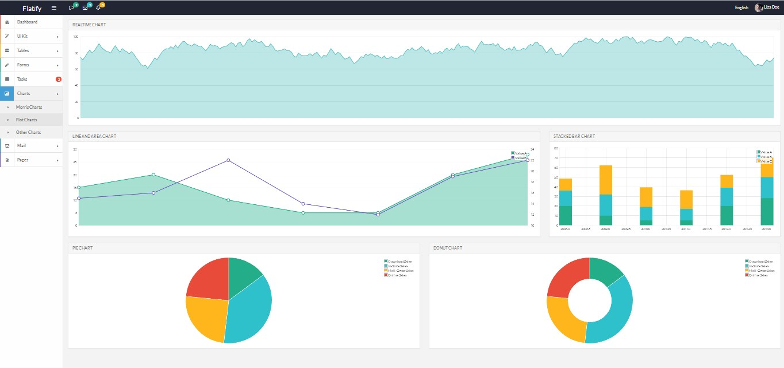
Historical Data and Analysis
Not actual web app
Get insight from your data to improve business strategy

Slide 16
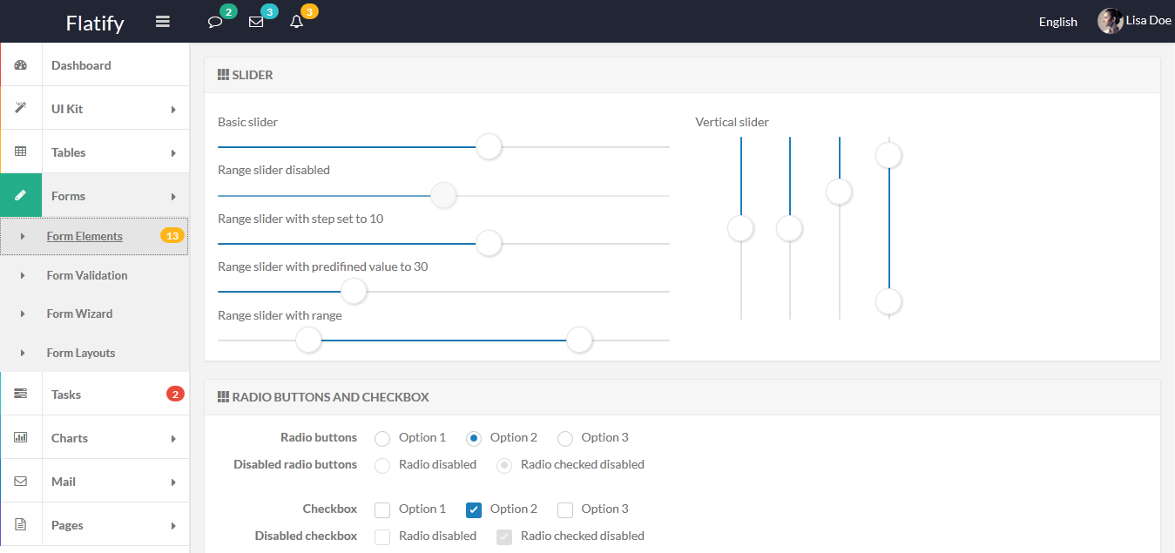
Configuration
Not actual web app
Configure device and parameter to be measured from web app

Slide 17
Timeline
Development
(2 months)
Demo
(1 week)
Production and testing
(1 month)
Deployment
(1 week)

Slide 18
Demo
Specification
Device
Support 3 SIM cards
Has GPS
Able to be operated in car
Has local database (one week data storing)
Web app
Performance comparison
Reporting

Slide 19
Demo Cont.
Measured parameter
Operator name
Signal strength
Network type (cellular and internet)
Ping duration (min, avg, max, mdev)
Download and upload speed
Connected tower
Voice:
PESQ MOS
POLQA MOS
SMS
Service accessibility
Message delivery rate
Message delivery time
Website
Load time
Response status
Chatting app
Ping duration to app server

Slide 20
Summary

Slide 21
Tritronik QoS Tool
Tritronik offers tool to collect services info from multiple MNOs. It can be installed on vehicles.
The information are related to voice call, SMS, and internet services.
Those info could be accessed from web app. It shows quality comparison between MNOs service, intelligent map, and analytics.
The overall timeline are around 4 months, and demo will be done after two month development.

